Slide 1
Mixture system
Double checking the equal-pressure, equal-temperature mixing solutions derived by Philip
Single phase
Exploring potential scaling law for cold curves generated for a series of elements by the LLNL Purgatorio code

Slide 2
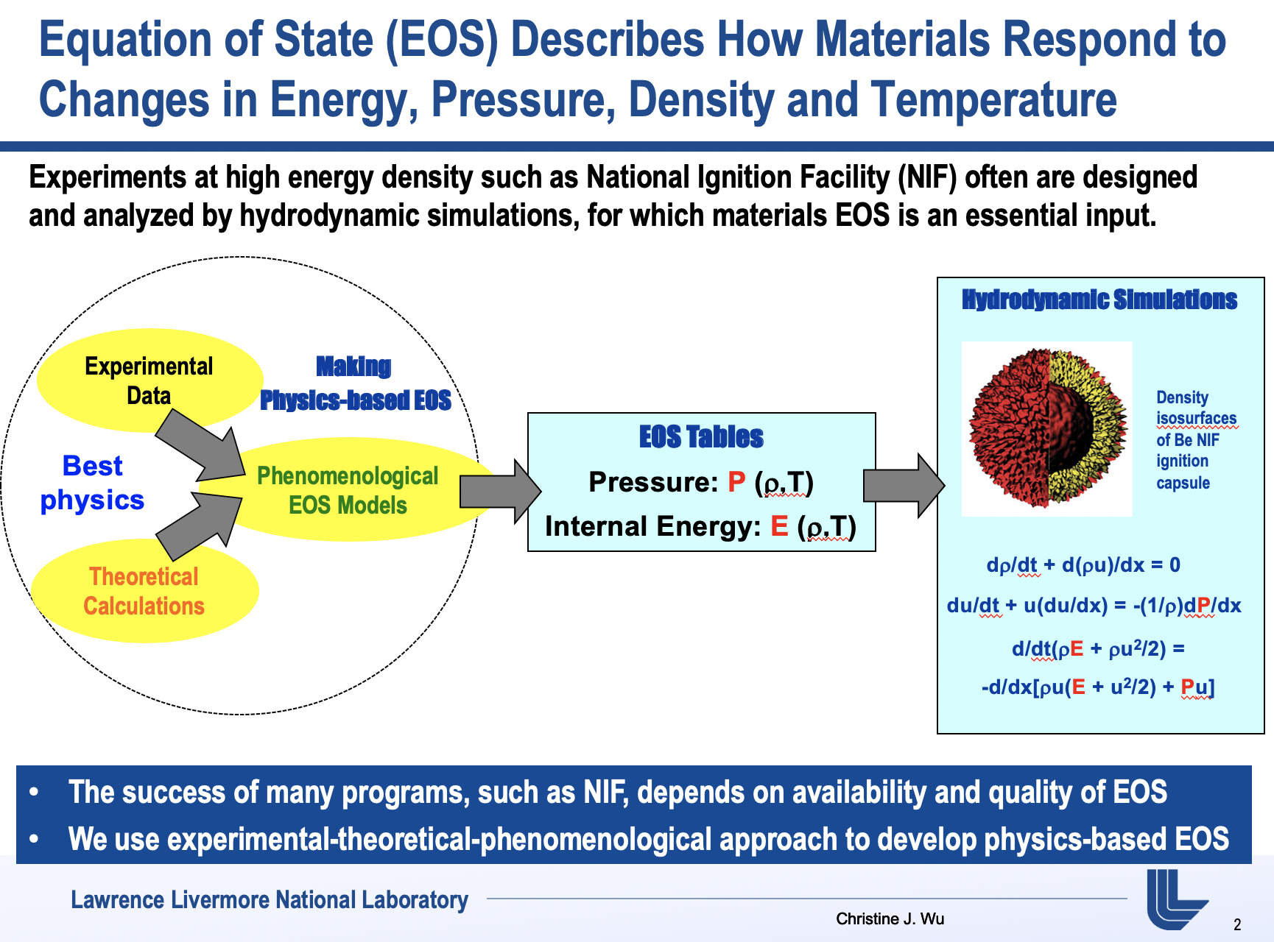

Slide 3
Free energy modeling of a single phase

Slide 4
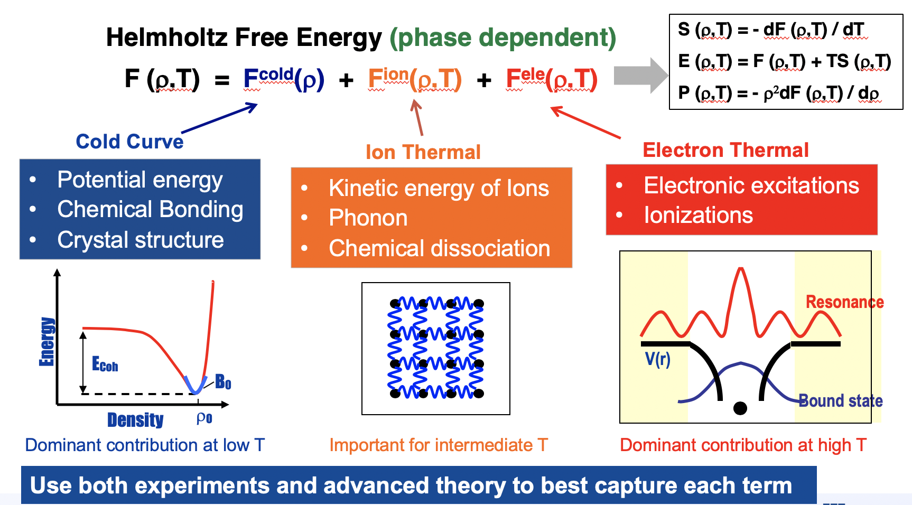
Standard decomposition of free energy

Slide 5
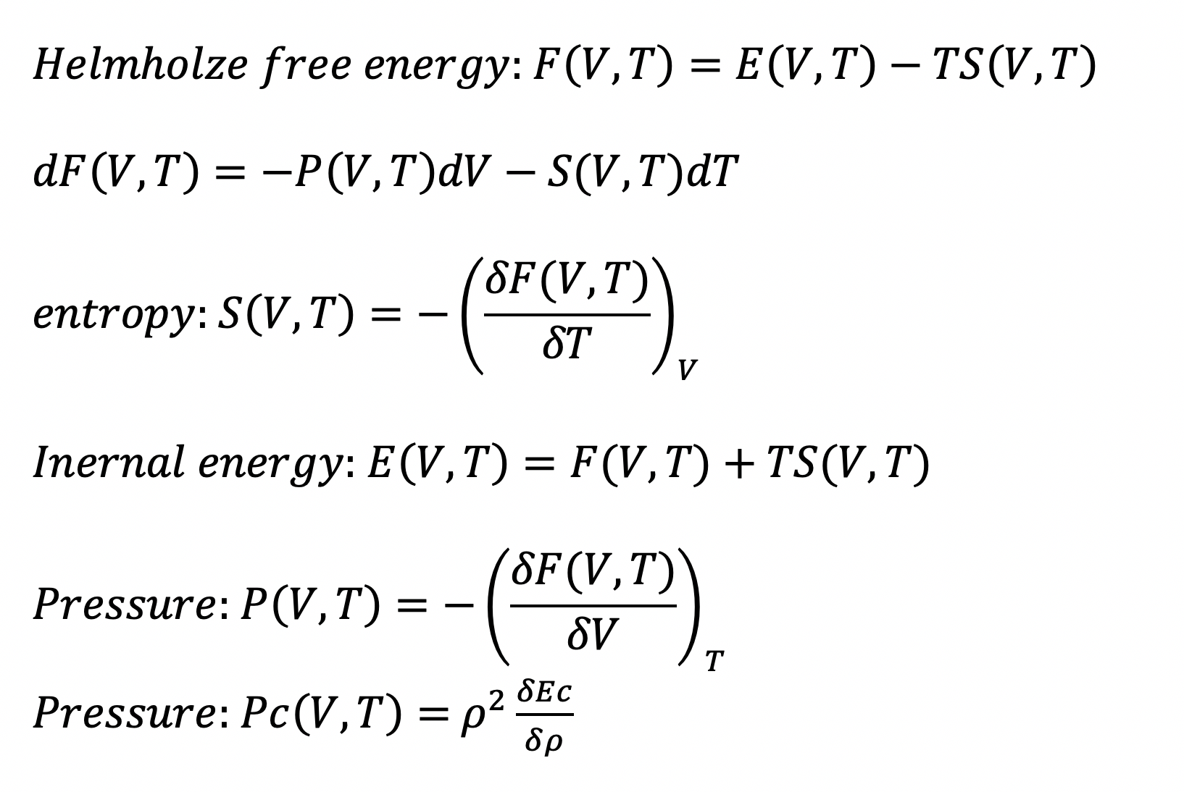
Other functions derived from free energy

Slide 6
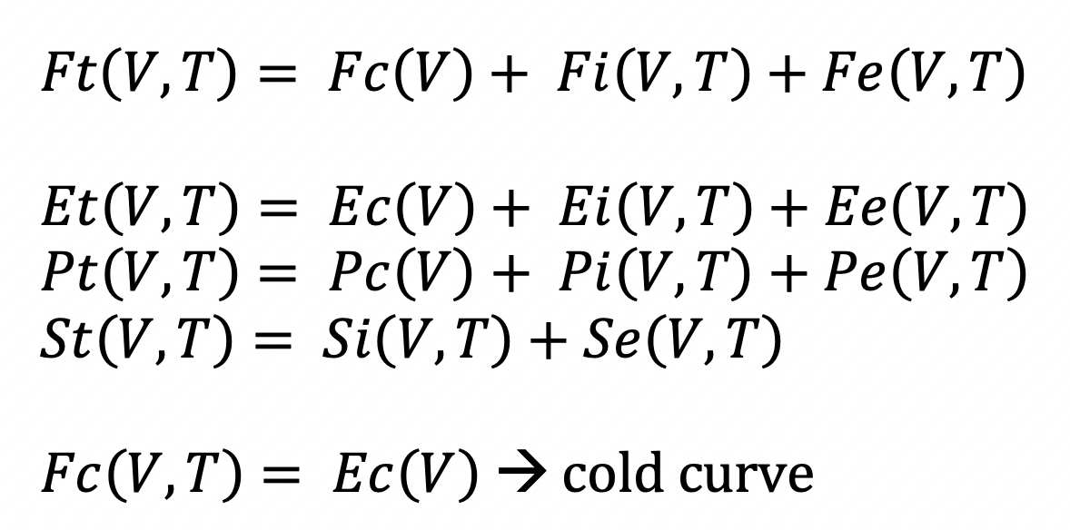
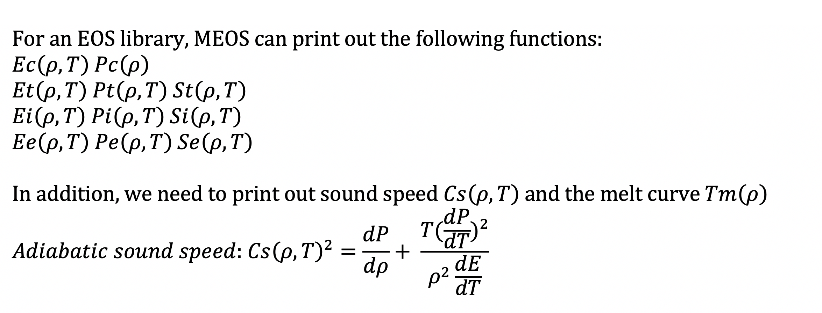

Slide 7
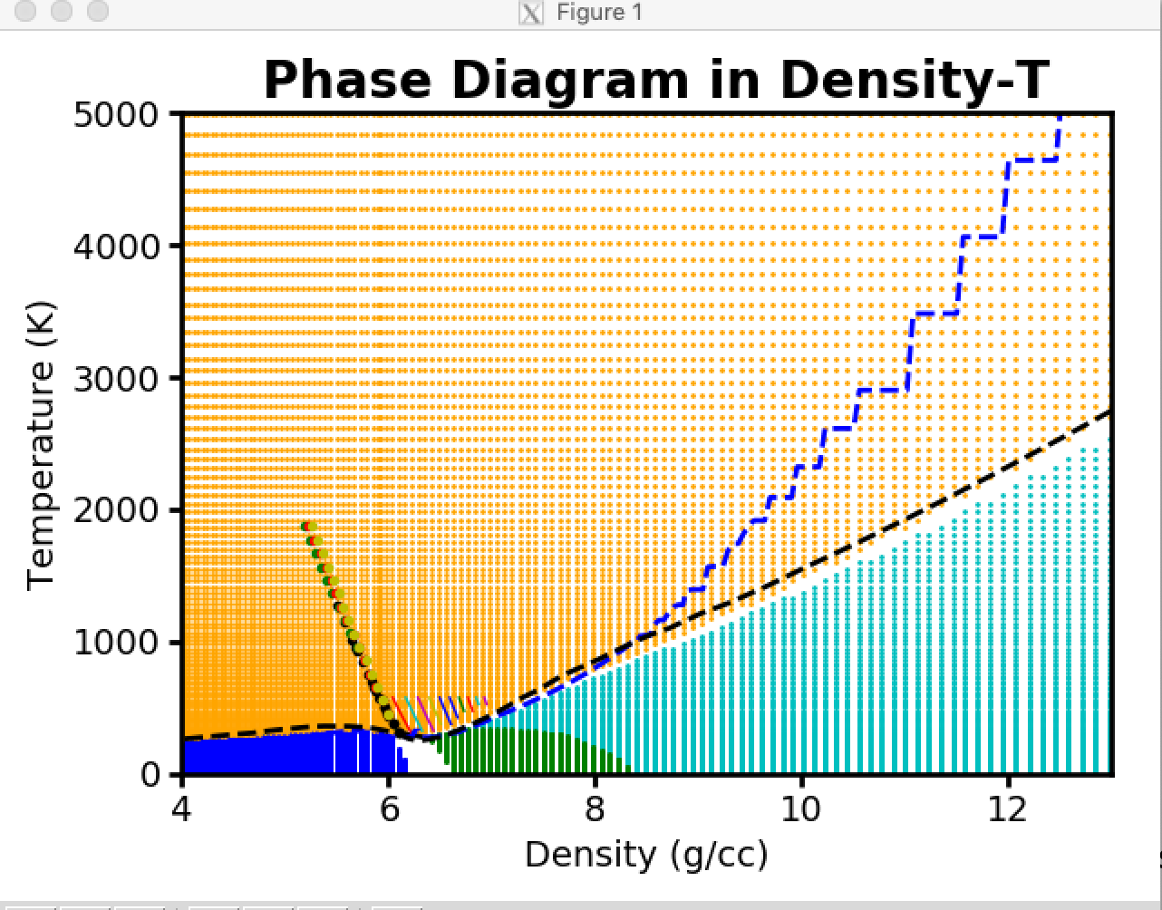
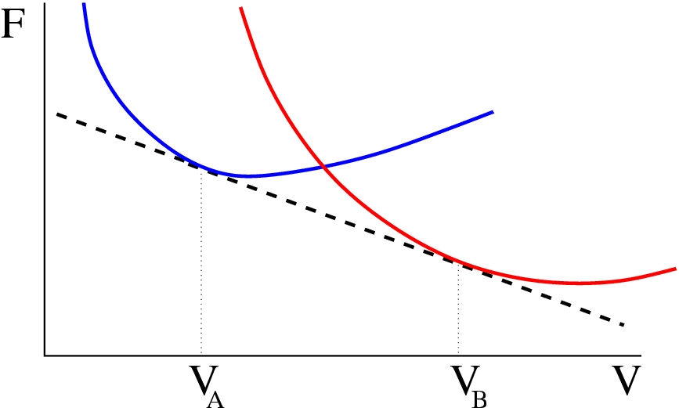
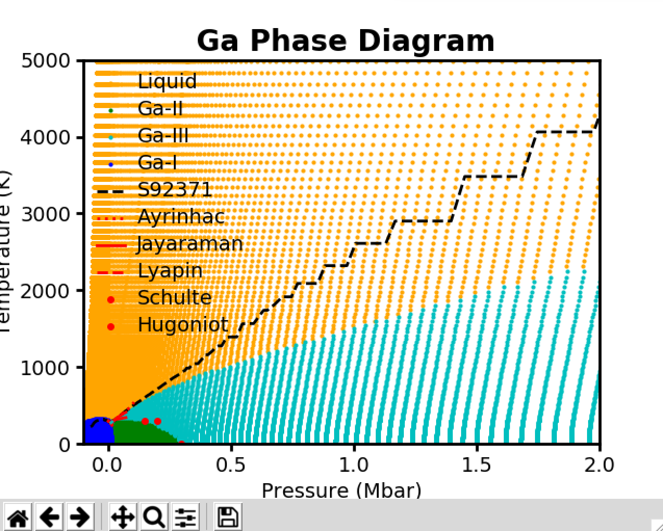
Multiphase construction
Multi-Phase Approach
Construct free energy for each phase
Maxwell construction → Phase transition
… for each isotherm
F_{A}(V_{A}) - F_{B}(V_{B}) = - P (V_{B} - V_{A})
“Flattened”
= NO metastable
extensions

Slide 8
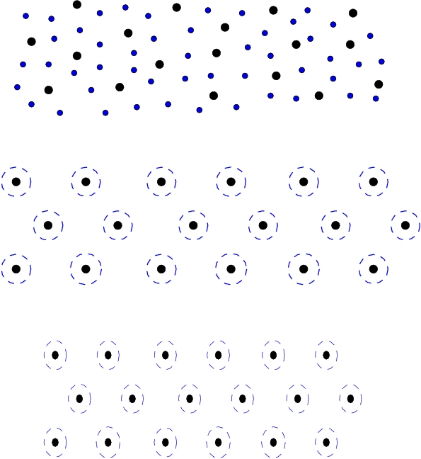
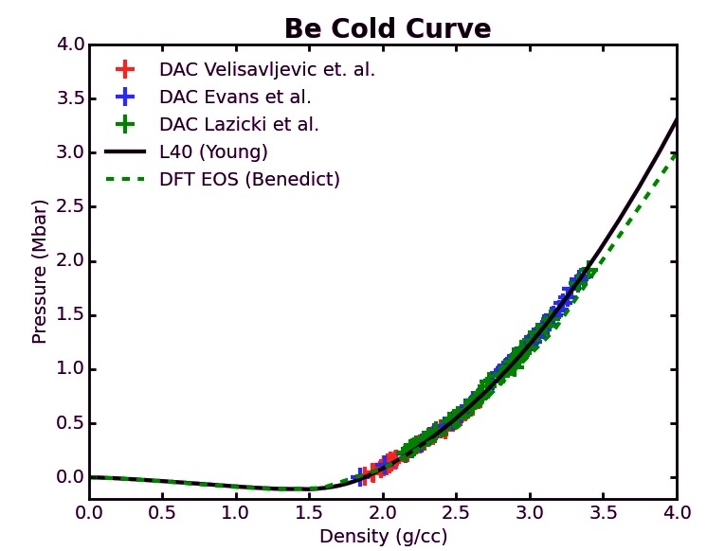
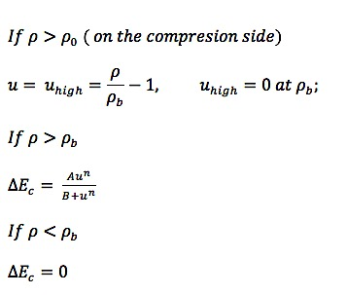
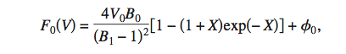
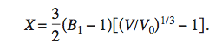
Cold Curve: Beyond Analytical Functions
One example of Be hcp cold curve
DFT
Breakpoint
EXP
Vinet
Soft-sphere model
B₁ does not change
Traditional treatment of cold curve: using analytical functions

Slide 9
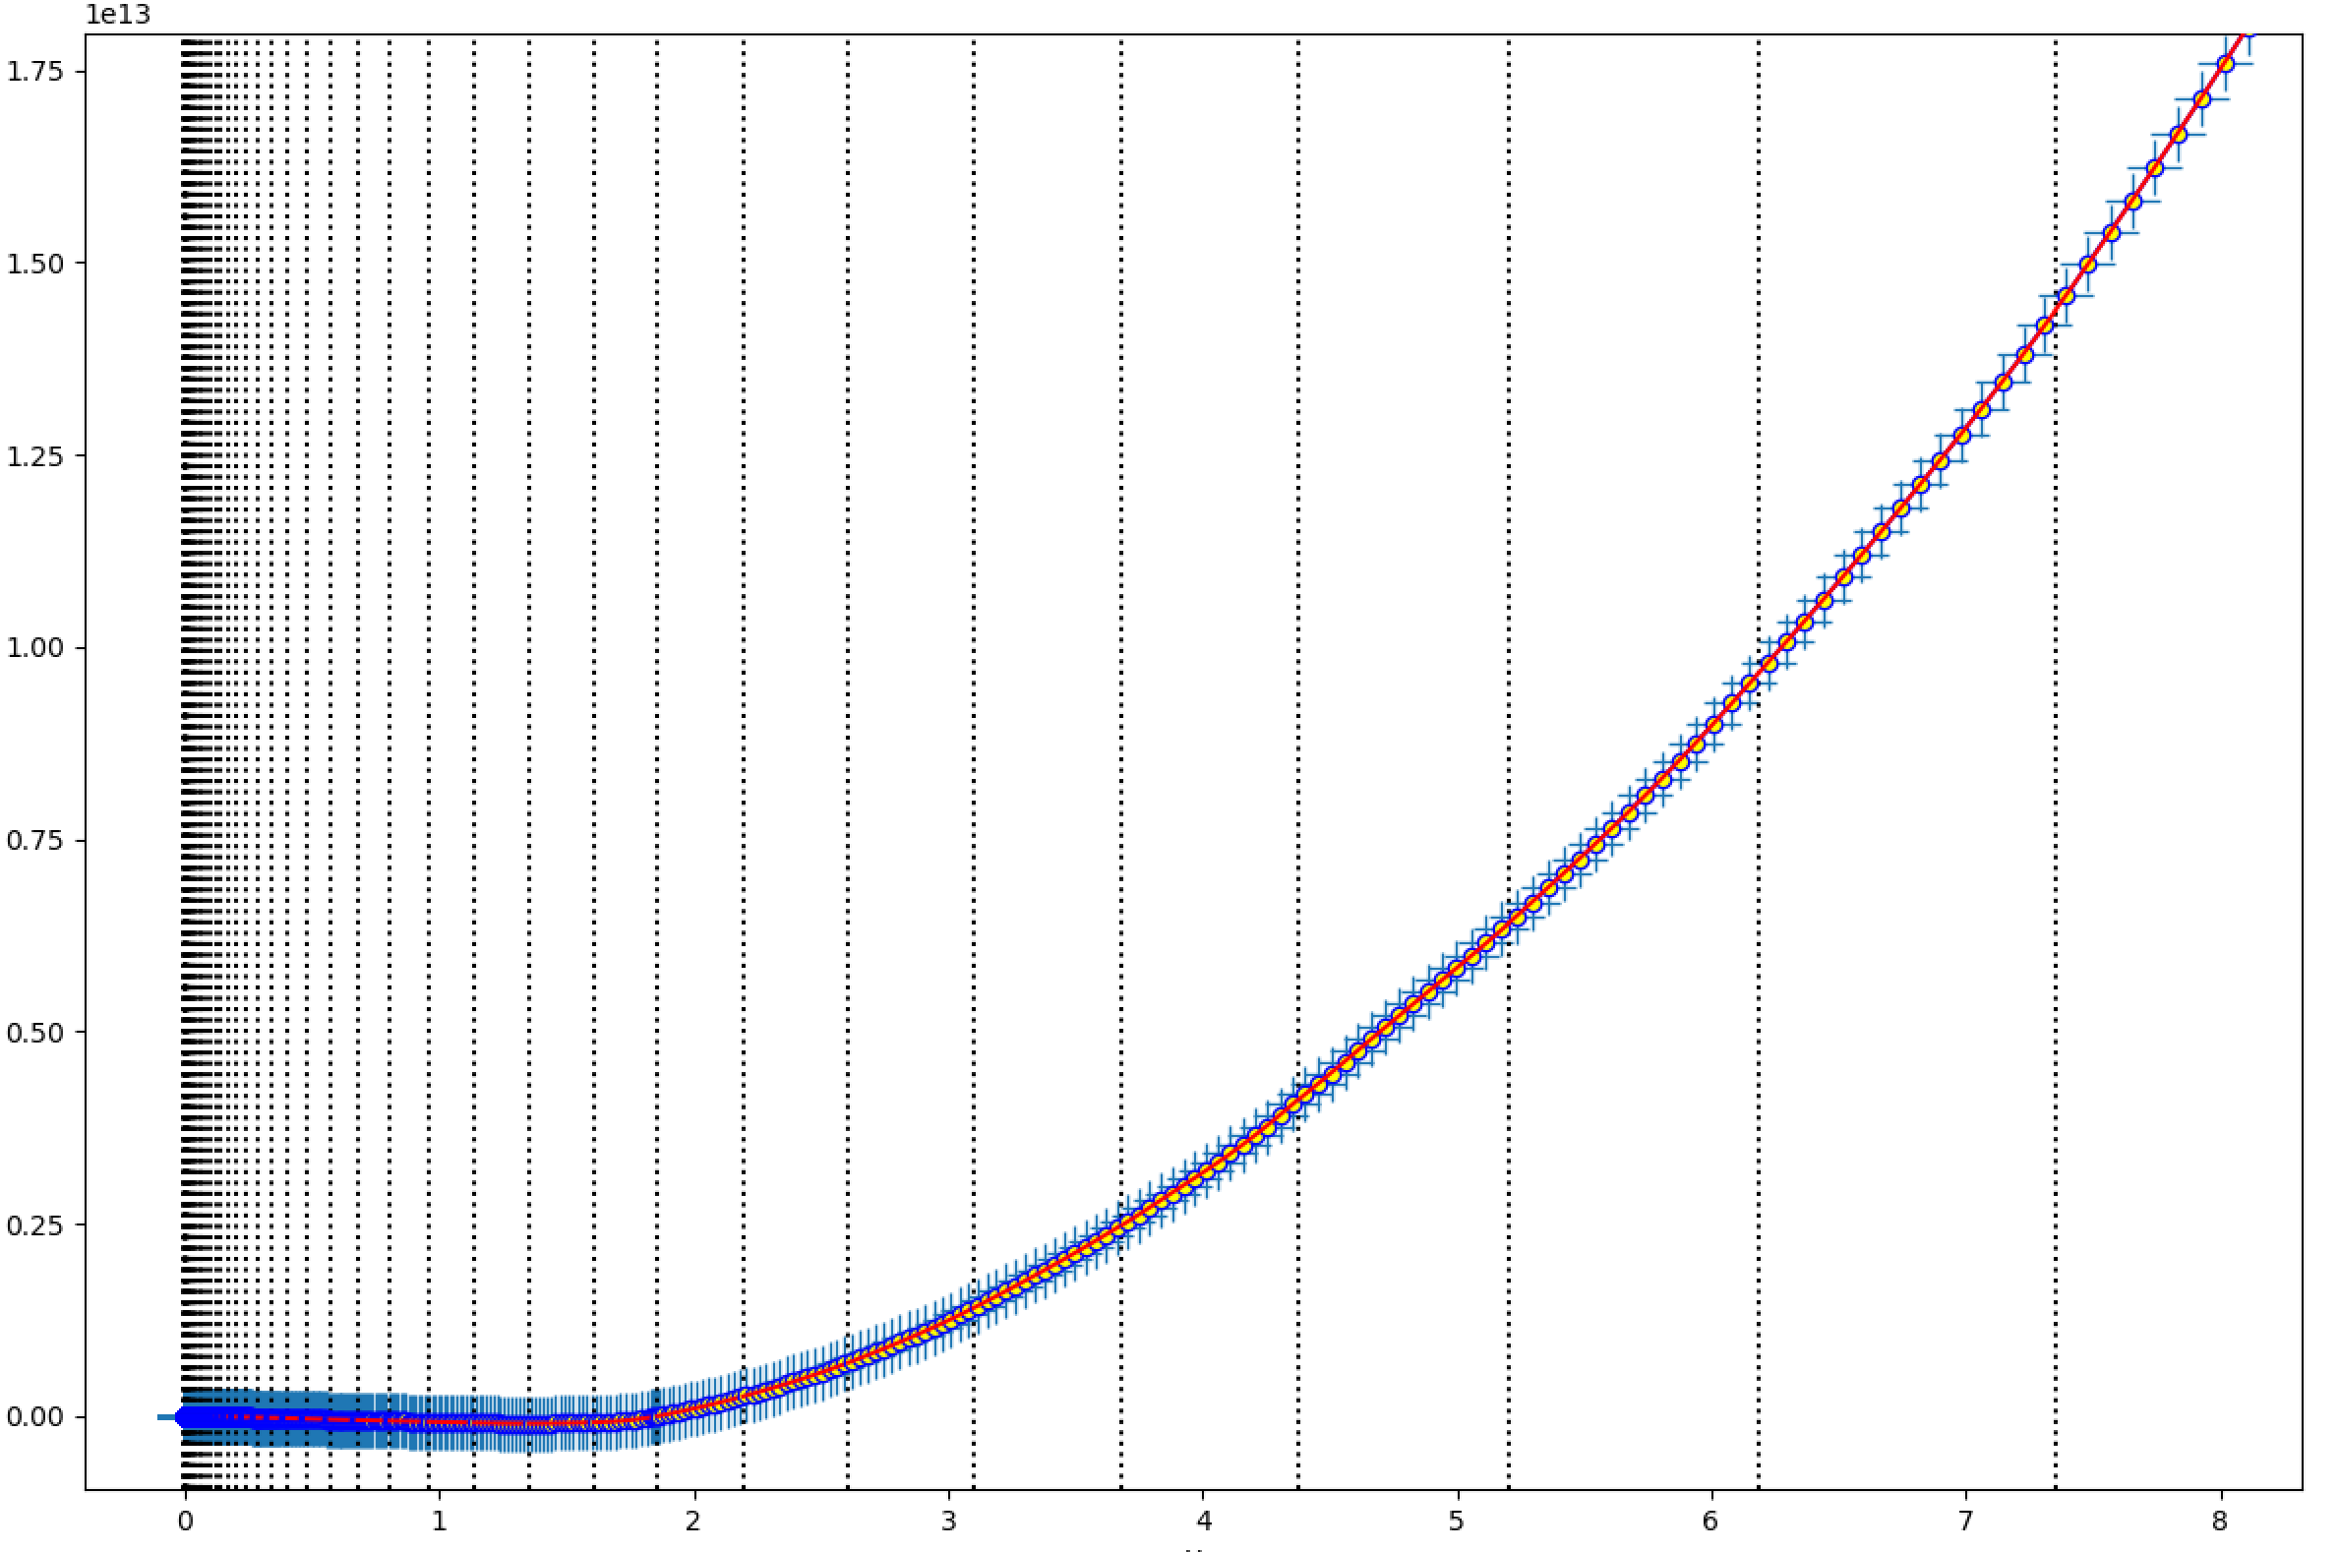
curvallis.py --input Pc_hcp.dat --back Pc_hcp.dat --region_data_points 15 --x_max 8

Slide 10
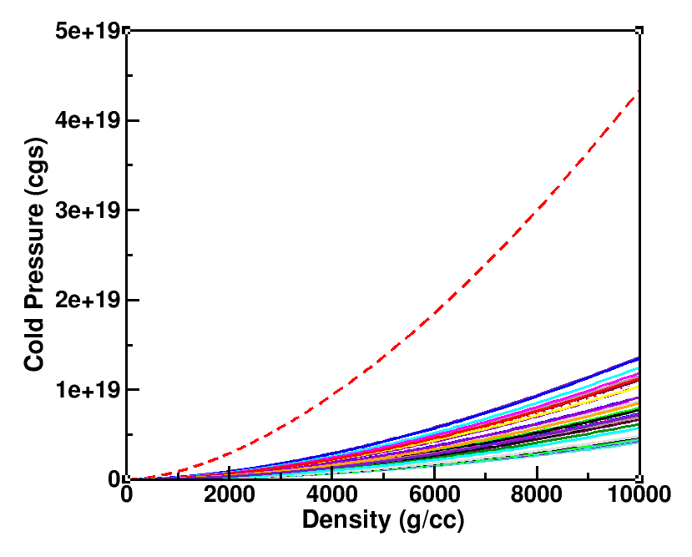
Ag/ Ar/ Au/ Bi/ Cl/ Cr/ D/ Fe/ Ga/ H/ Kr/ Mg/ Mo/ Ne/ Pb/ Po/ Re/ S/ Sn/ T/ Ti/ Y/ Zr/
Al/ As/ Be/ Ce/ Co/ Cu/ F/ Fr/ Ge/ He/ Li/ Mn/ N/ Os/ Pd/ Pt/ Rh/ Se/ Sr/ Ta/ Xe/ Zn/
H

Slide 11
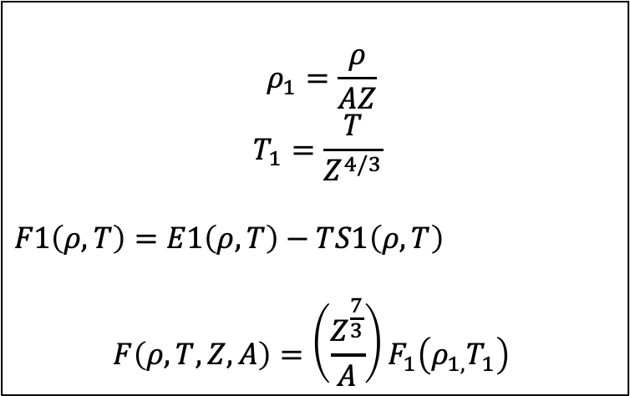
Scaling for TF table:
$$ρ_{1}=\frac{ρ}{AZ}$$
$$T_{1}=\frac{T}{Z^{4/3}}$$
$F1\left(ρ,T\right)=E1\left(ρ,T\right)−TS1\left(ρ,T\right)$
$$F\left(ρ,T,Z,A\right)=\left(\frac{Z^{\frac{7}{3}}}{A}\right)F_{1}\left(ρ_{1,}T_{1}\right)$$

Slide 12
